Slide 1
B.Tech – CSE – Sem. 3 18CSS201J – ANALOG AND DIGITAL ELECTRONICS (Regulations 2018)
UNIT 4
Session-11( Asynchronous Sequential Circuits, Transition Table)
Session-12( State Table, Flow Table)

Slide 2
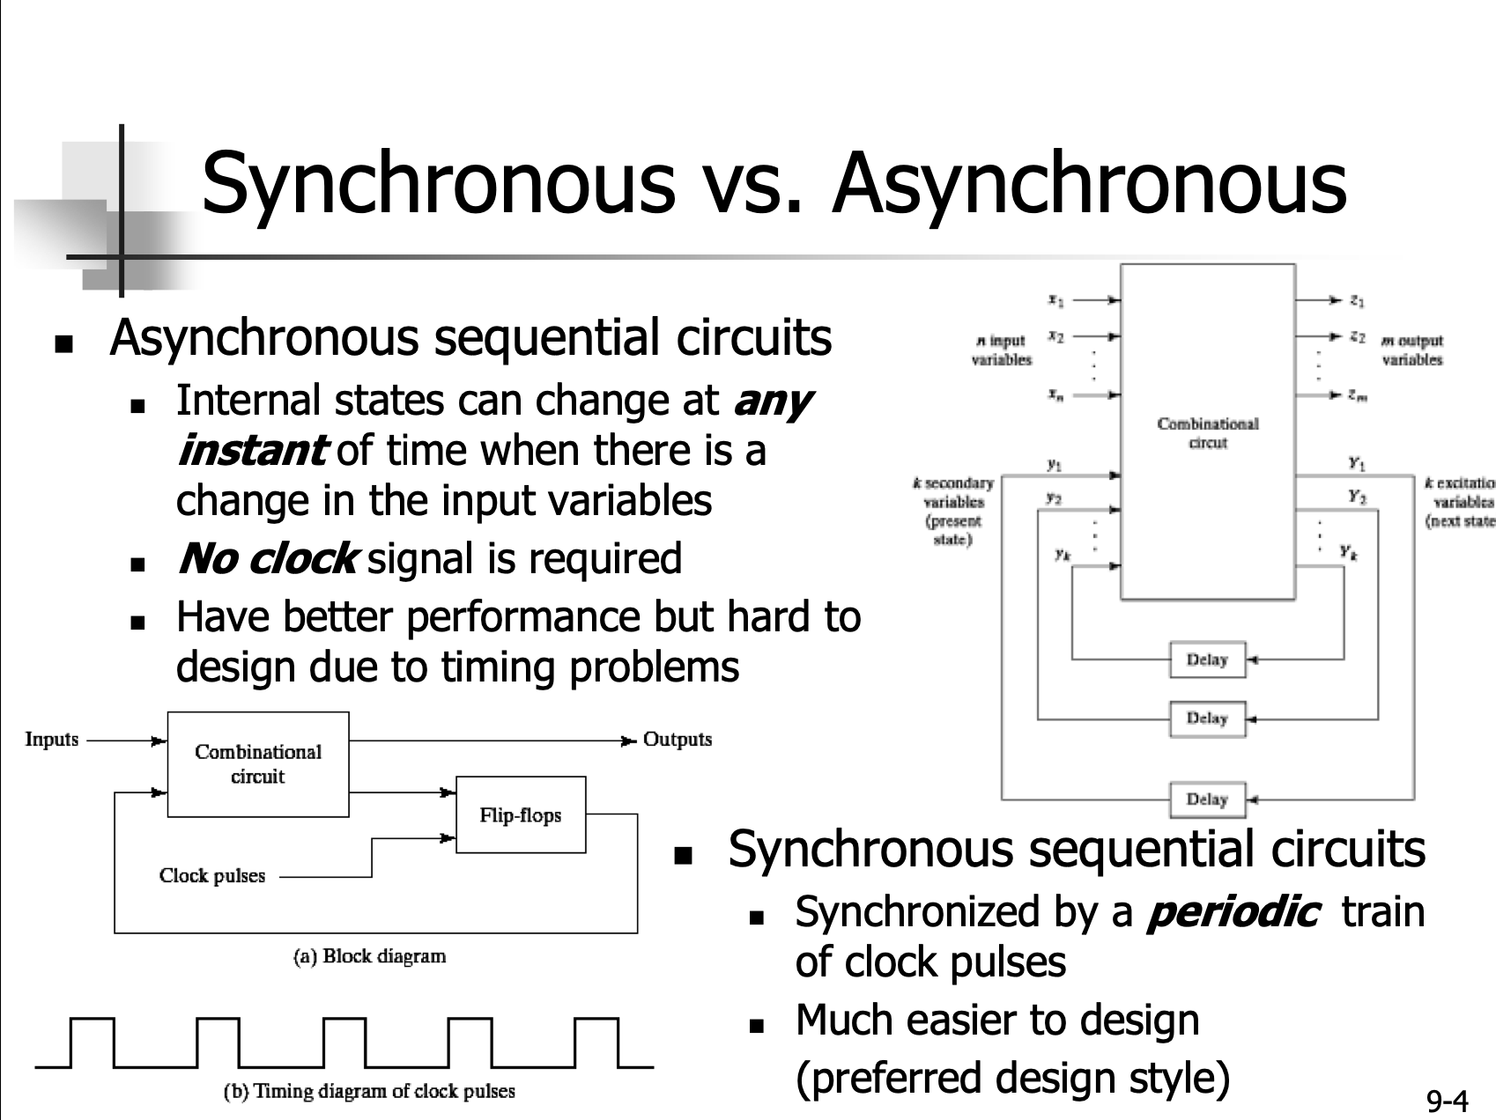

Slide 3
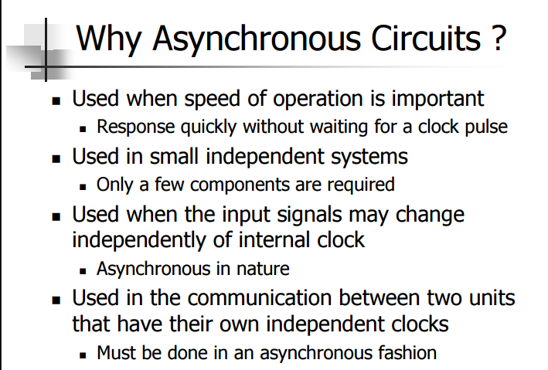

Slide 4
Definitions:
State Table:
The relationship that exists among the inputs, outputs, present states and next states can be specified by either the state table or the state diagram
Transition Table:
Transition table is table of states and transition, useful to analyze an asynchronous circuit from the circuit diagram
Flow Table:
In a flow table the states are named by letter symbols

Slide 5
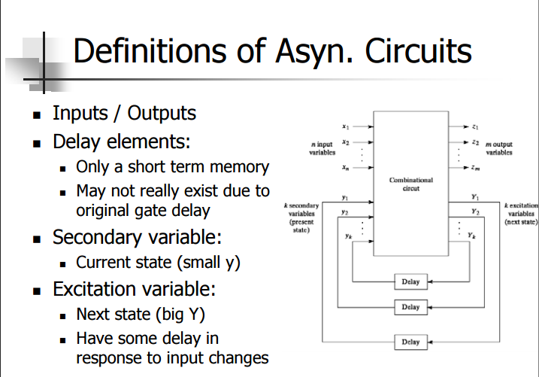

Slide 6
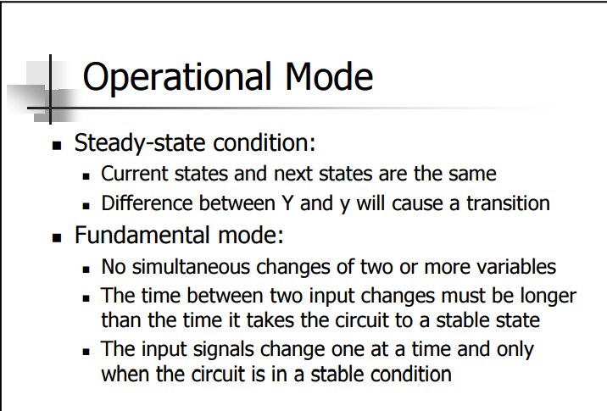

Slide 7
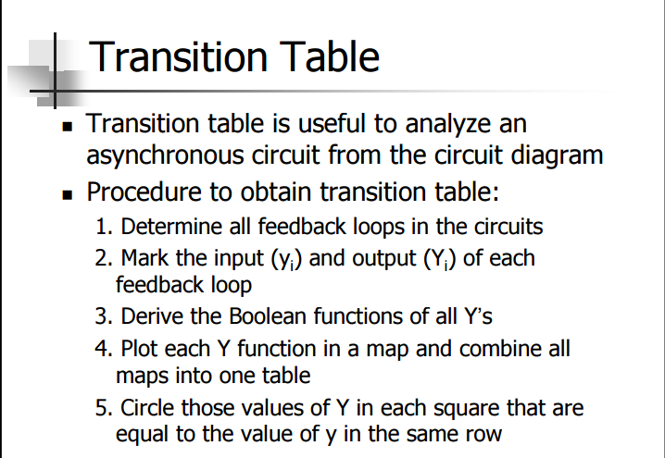

Slide 8
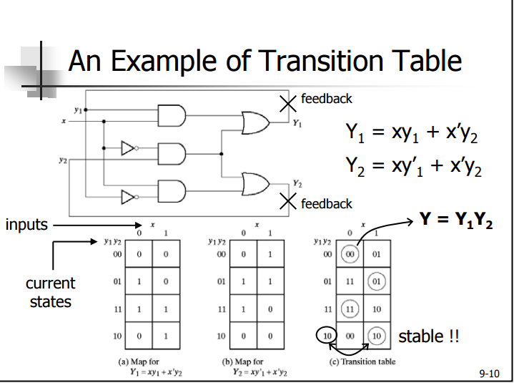

Slide 9
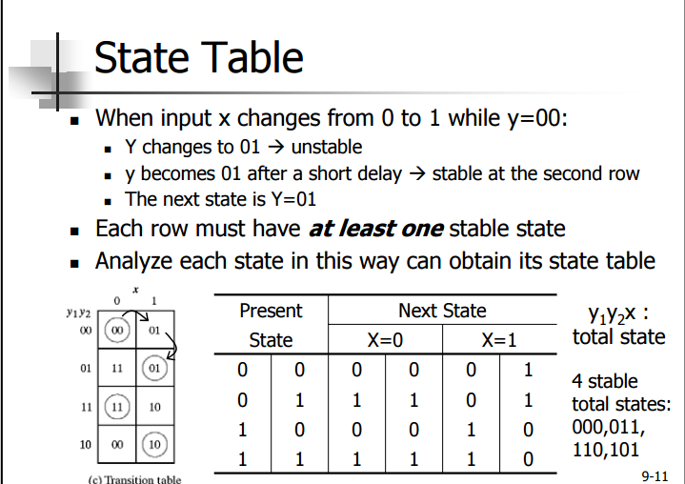

Slide 10
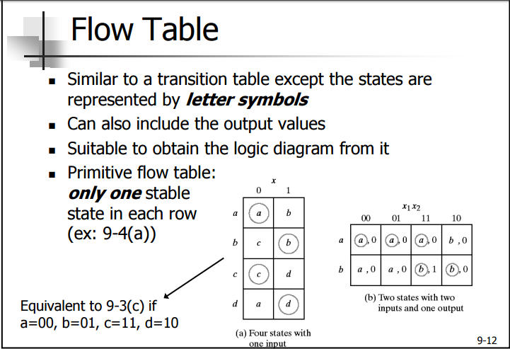

Slide 11
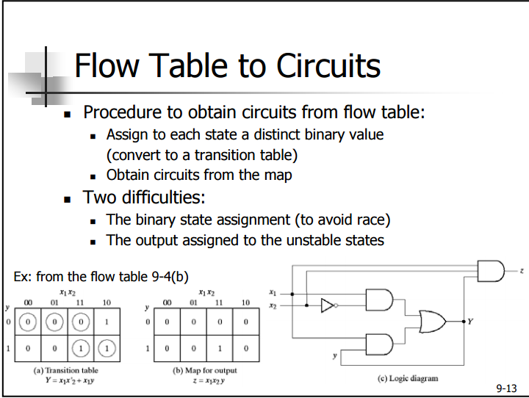

Slide 12
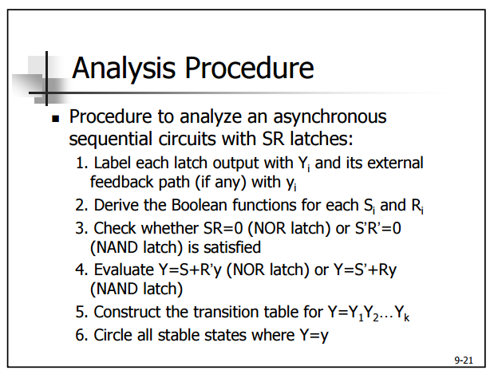

Slide 13
